Slide 1
Dog Speak
For each picture shown, use the Dog Speak Interpretations worksheet to describe what each dog is saying. Use quotation marks to describe what the dog in each picture is trying to say.
Understanding Dog Language, Upper Elementary: Day 2
Michigan Humane Society www.michiganhumane.org

Slide 2
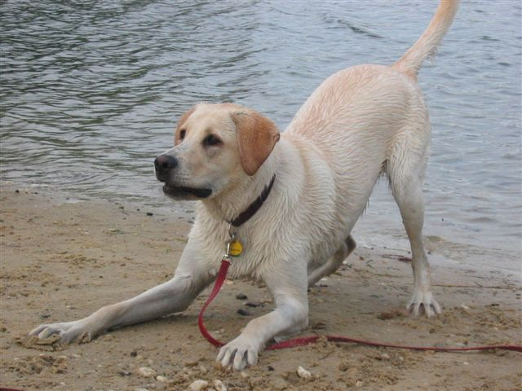
1

Slide 3
#1 The Play Bow
“Let’s Play!”
This dog is inviting you to play.
He or she is trying to convey that everything is fun and games, and no stress is present.

Slide 4
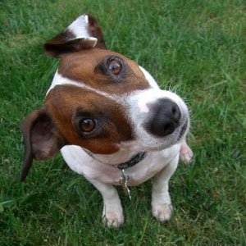
2

Slide 5
#2 The Head Turn
“What did you say?”
Dogs tilt their heads to hear us better.
They do this to further identify where a sound is coming from.
The dog is telling you that it is curious about a sound you made.

Slide 6
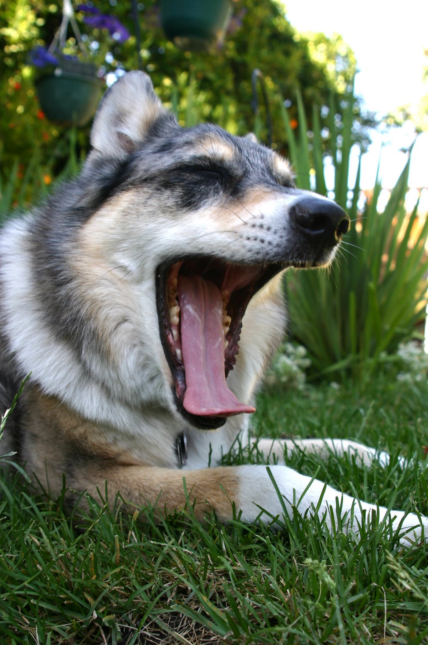
3

Slide 7
#3 Dog Yawn
“I’m a little worried.”
This dog is trying to calm his surroundings or deflect a threat.
The dog feels threatened or anxious, but is not planning to attack.

Slide 8
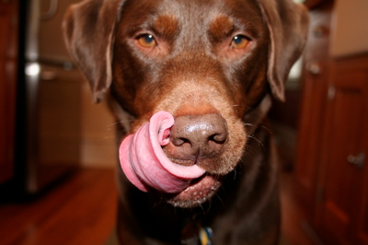
4

Slide 9
#4 The Lip Lick
“I’m hungry” or “I need some space”
If you’re holding a treat, this dog is probably hungry (or licking food off of his nose!)
Otherwise this dog is telling you that he may be anxious, stressed, and needs some space.

Slide 10
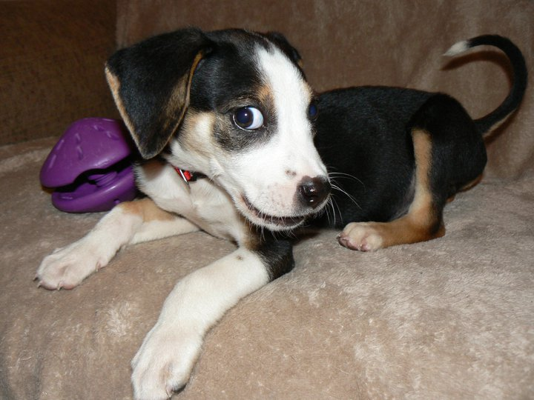
5

Slide 11
#5 The Whale Eye
“I’m uncomfortable; Back off!”
“Whale eye” is a term used by dog trainers when a dog averts its head slightly and you can see the whites of its eyes.
It is telling you that it is anxious and feels uncomfortable.
A bite may result due to the stress that it is feeling.

Slide 12
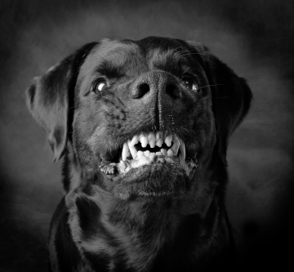
6

Slide 13
#6 The Growl
“I’m about to attack!”
Violent growls, like the one pictured, are symbolized by bare teeth.
A dog uses the growl as a warning sign to stop the action you are doing or it may become violent.
Lighter toned growls without bared teeth can mean the dog wants something or may be in pain.
Always use caution when you are near a growling dog!

Slide 14
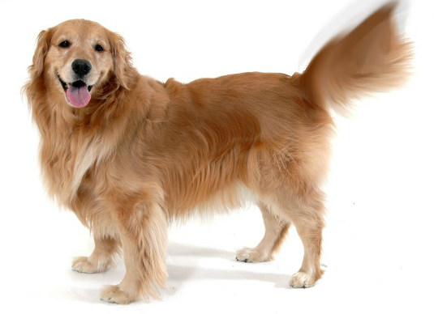
7

Slide 15
#7 The Tail Wag
“I’m happy and content.”
If a dog is wagging its tail and the rest of his body seems relaxed or is moving along with the wagging, you are dealing with a happy, comfortable dog.
If a dog is holding its body straight and rigid (or whining) while wagging its tail, it may be feeling territorial or uncomfortable.

Slide 16
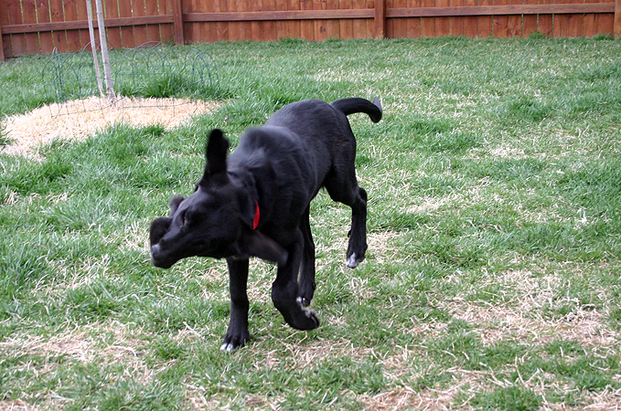
8

Slide 17
#8 The Body Shake
“I’m wet!” or “Let’s start over.”
May be used for dogs to dry off.
If the dog is not wet, they often do the body shake when they are trying to relieve tension or show that they are moving on to a different activity.
It is like a doggy reset button.

Slide 18
Why Is It Important To
Understand Dog Communication?
Dogs are one of the most common household pets. Understanding what a dog is trying to communicate is very beneficial to both you and the dog.
Children are the biggest target for dog bites, because they often cannot read a dog’s warning signals. By understanding when a dog is upset, nervous, or stressed out, you can help keep yourself safe.
Understanding dogs helps improve pet-to-human relationships.
Understanding dogs may help prevent unnecessary punishments to dogs based on simple misunderstandings in communication between the human and pet.

Slide 19
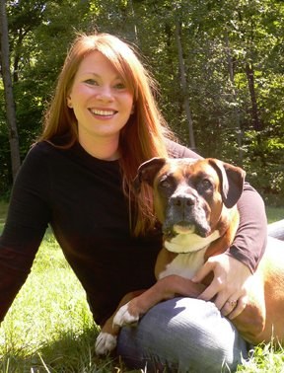
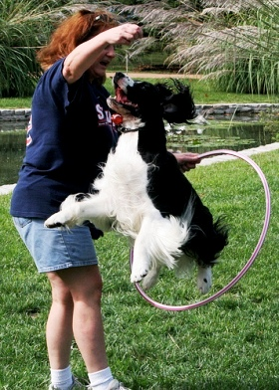

Expert Sources
Colleen Safford- Founder of New York Walk & Train and Far Fetched Acres and is one of NYC's most recognized dog trainers. Her actions earned her the title of "Best in NY" by New York Magazine. Colleen is also the featured trainer in Nylabone's entire book and DVD series for new dog owners and serves as host of The Family Pet on Pet Life Radio.
Linda Cole- well known dog expert and writer for the Responsible Pet Ownership blog.
Amy Bender- Amy is a member of the Association of Pet Dog Trainers. She has also written a number of articles about dogs for both print and the web. She specializes in educating the public about dog behavior and behavior assessments of shelter dogs.

